Slide 1
CV WRITING 1

Slide 2
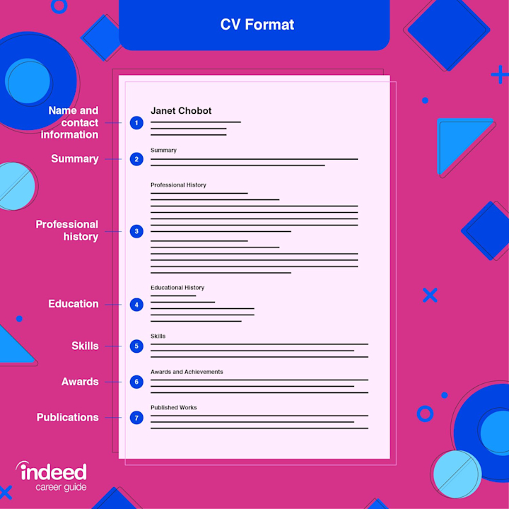

Slide 3
Résumé vs CV
By the way, if employers ask to see your “CV,” they’re referring to your curriculum vitae, the term used instead of résumé in academic professions and in many countries outside the United States.
Résumés and CVs are essentially the same, although CVs can be much more detailed and include personal information that is not included in a résumé.

Slide 4
CV/Resume writing
CV/ Resume-- a structured written summary of your education, employment background , and job qualification.
A wide range of opinions about resumes, regarding everything from appropriate length, content, design, distribution methods, and acceptable degrees of creativity to whether it even makes sense to write traditional resume in this age of online applications.
To forge your own successful path through this maze of information, get inside the heads of the people you are trying to reach—try to think the way they think—and then apply the principles of effective communication.

Slide 5
3 stages of CV/ Resume
Plan
Write
Complete

Slide 6
Planning of Resume writing
Analyze the situation (Purpose)
Gather information (target industries/ universities)
Choose Media and Channels
Organize the information

Slide 7
Writing of Resume
Plan your wording carefully so that you catch a recruiter’s eye within seconds; translate your education and experience into attributes that target employers find valuable.
Write clearly and succinctly, using active, powerful language that is appropriate to the industries and companies you are targeting; use a professional tone in all communications.

Slide 8
Complete your Resume
Revise the message (Content)
Produce the message (Layout, graphical and text elements)
Proofread the message (Review for errors in layout, spelling)
Distribute the message (Follow specific instruction of employer)

Slide 9
Analyzing your purpose and audience
The purpose of a résumé is not to get you a job but rather to get you an interview.
As you conduct your research on various professions, industries, companies, and individual managers, you will have a better perspective on your target readers and their information needs. Learn as much as you can about the individuals who may be reading your résumé.

Slide 10
Gathering Pertinent information
Gather all the pertinent personal history you can think of, including all the specific dates, duties, and accomplishments from any previous jobs you’ve held.
Compile all your educational accomplishments, including formal degrees, training certificates, professional and technical certifications, academic awards, and scholarships.
Gather information about school or volunteer activities that might be relevant to your job search, including offices you have held in any club or professional organization, presentations given, and online or print publications.

Slide 11
Fallacy and facts of resume
Fallacies
Facts
The purpose of a résumé is to list all your skills and abilities.
Your résumé will always be read carefully and thoroughly
The purpose of a résumé is to kindle employer interest and generate an interview.
In most cases, your résumé needs to make a positive impression within a few seconds; only then will someone read it in detail. Moreover, it will likely be screened by a computer looking for keywords first—and if it doesn’t contain the right keywords, a human being may never see it

Slide 12
Types of Résumé
The Chronological Résumé
The Functional Résumé
The Combination Résumé

Slide 13
Addressing areas of concern
Frequent job changes
Gaps in job history
Inexperience
Over qualification
Long- term employment with one company
Job termination for cause
Criminal record

Slide 14
Writing your cv/ resume
Keep honest in your cv/ resume
Adopting your cv/ resume to your audience

Slide 15
Compose your CV/ Resume
Write your CV/résumé using a simple and direct style. Use short, crisp phrases instead of whole sentences and focus on what your reader needs to know.
Avoid using the word I, which can sound both self-involved and repetitious by the time you outline all your skills and accomplishments.

Slide 16
accomplished coordinated Initiated participated set up achieved created Installed performed simplified | administered demonstrated introduced planned Sparked approved Developed investigated Presented streamlined | arranged Directed launched proposed strengthened assisted established maintained raised succeeded | assumed explored managed recommended supervised budgeted forecasted motivated reduced systematized

Slide 17
Organizing Your Information Into Effective Résumé Categories
Summary of qualifications
Education
skills, awards and activities
Personal information
References
career objective

Slide 18
Main Heading
should start with a main heading that is as uncluttered and simple as possible.
The first line of the main
heading should always be your name; add your middle initial for an even more
professional look. Format your name so that it stands out on the page. Below
your name, list your contact information, including your complete address, area
code and phone number, and e-mail address. Be sure to include a telephone number where you can receive messages.

